Slide 1

Deep Learning

Slide 2

Application of Deep Learning
Virtual Assistants
Cloud-based applications that understand natural language voice commands and complete tasks for the user.
They need internet-connected devices to work with their full capabilities.
Each time a command is fed to the assistant, they tend to provide a better user experience based on past experiences using deep learning.
Examples:
Amazon Alexa, Cortana, Siri, and Google Assistant..

Slide 3

Application of Deep Learning
Chatbots
It can solve customer problems in seconds
It can help the client in the chat online via text or text-to-speech.
It is capable of communicating and performing actions similar to a human.
It uses machine learning and deep learning algorithms to generate different types of reactions.
Example Use Case:
Customer interaction on online store and marketing on social network sites..

Slide 4

Application of Deep Learning
Health Care
Deep Learning has found its application in the Healthcare sector.
Computer-aided disease detection and computer-aided diagnosis have been possible using Deep Learning.
Example Use Case:
Medical research, drug discovery, and diagnosis of life-threatening diseases such as cancer and diabetic retinopathy through the process of medical imaging.

Slide 5

Application of Deep Learning
Entertainment
Based on a person’s browsing history, interest, and behavior, online streaming companies give suggestions to help them make product and service choices with the help of deep learning.
It provides relevant movies, songs, and video recommendations to enhance their customer experience.
It is also used to add sound to silent movies and generate subtitles automatically.
Example Companies:
Netflix, Amazon, YouTube, and Spotify

Slide 6
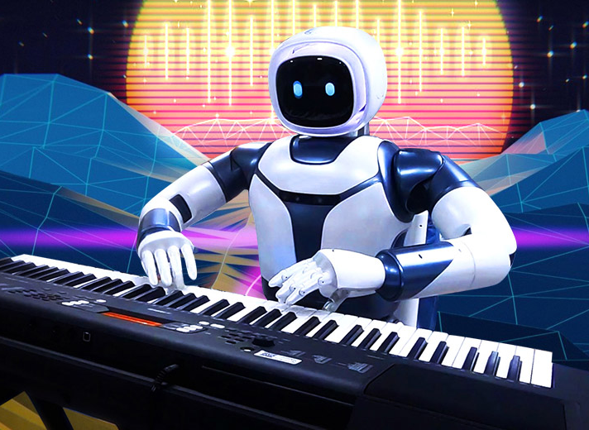
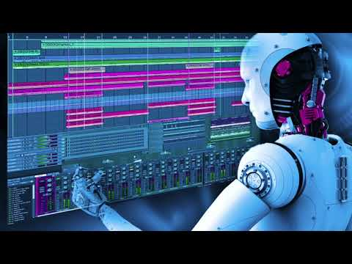
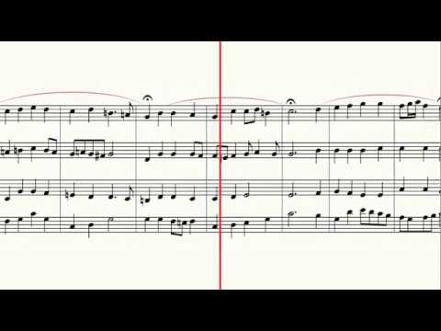
Application of Deep Learning
Music Industry
Deep learning can learn the notes, structures, and patterns of music and start producing music independently.
Deep Learning-based generative models such as WaveNet can be used to develop raw audio.
Long Short Term Memory Network helps to generate music automatically.
It allows us to train a system to develop music by teaching music theory fundamentals, generating music samples, and studying music

Slide 7
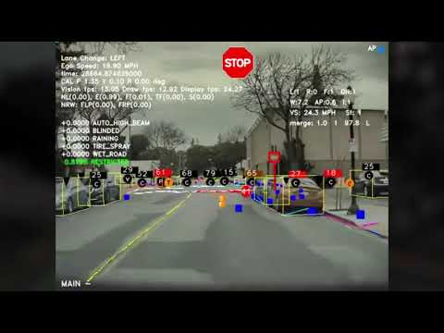
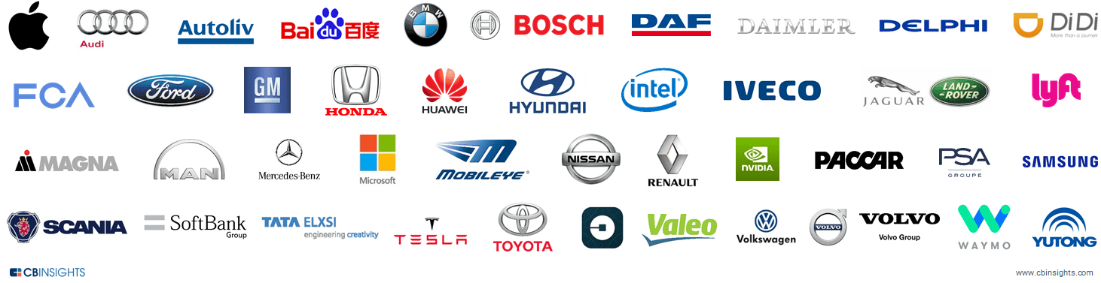
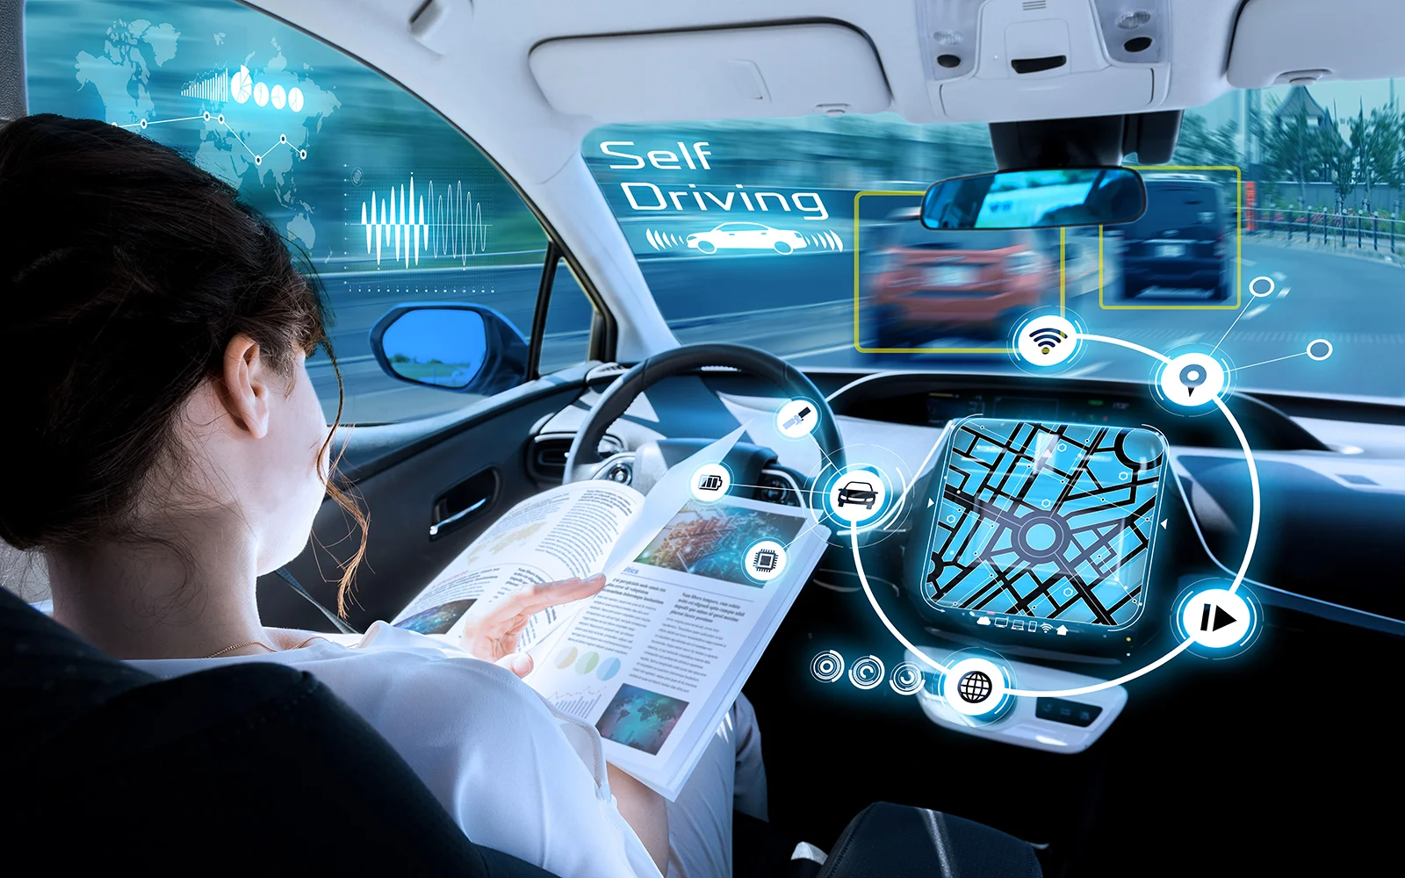
Application of Deep Learning
Self Driving Cars
Deep learning decides to act and respond using millions of data sets and training.
They have operational sensors for calculating adjacent objects.
Deep learning manoeuvre through traffic using data from its camera, sensors, geo-mapping, and sophisticated models.

Slide 8
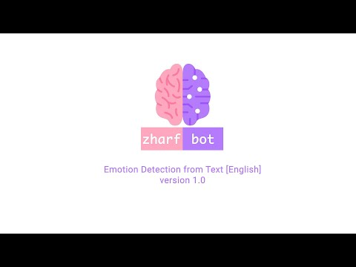
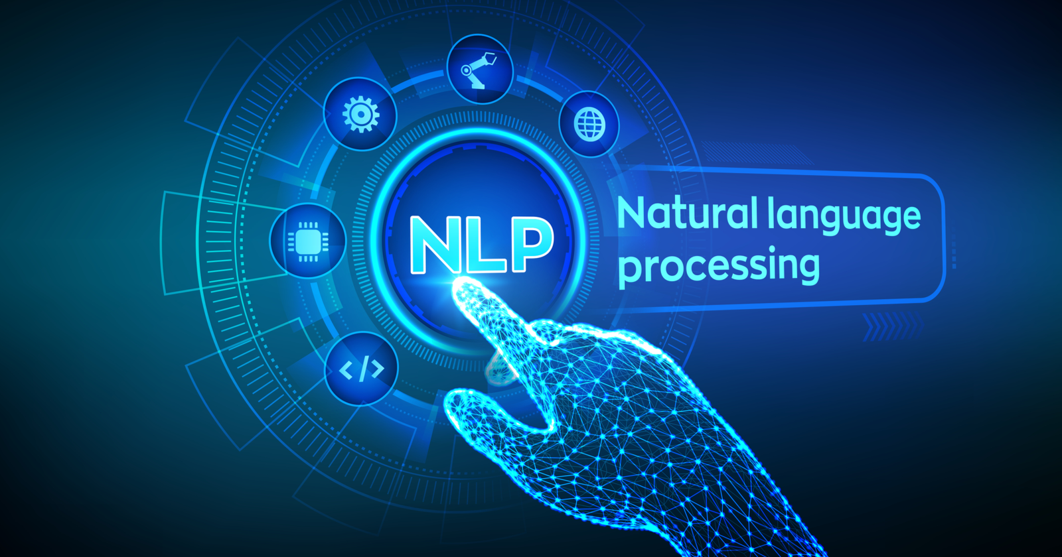
Application of Deep Learning
Natural Language Processing
It is the procedure for allowing robots to study and comprehend human language.
Many of the challenges associated with comprehending human language are being addressed by Deep Learning-based NLP by teaching computers (Autoencoders and Distributed Representation) to provide suitable responses to linguistic inputs.

Slide 9
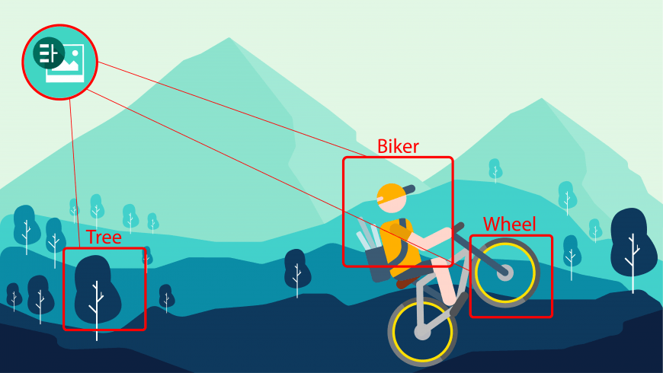
Application of Deep Learning
Visual Recognition
With help of deep learning, Images may be sorted using it based on places recognised in pictures, faces, a mix of individuals, events, dates, and so on.
To detect aspects when searching for a certain photo in a library, state-of-the-art visual recognition algorithms with various levels from basic to advanced are required.

Slide 10
Most Common Deep Learning Methods
Multilayer Perceptrons (MLPs)
Convolutional Neural Networks (CNNs)
Recurrent Neural Networks (RNNs)
Generative Adversarial Networks (GANs)
Deep Reinforcement Learning (DRL)

Slide 11
Multilayer Perceptrons (MLPs)
Example Applications:
Data Compression
Streaming Encoding
Data Security / Data Loss Protection
Image Recognition, Object detection, Route Adjustment
Customer Ranking

Slide 12
Convolutional Neural Networks (CNNs)
Example Applications:
Face detection
Facial emotion recognition
Object detection
Auto translation
Next word prediction in sentence
Handwritten character recognition
X-ray image analysis
Visual question answering
Image captioning
3D medical image segmentation
Document classification
Cancer detection
Biometric authentication

Slide 13
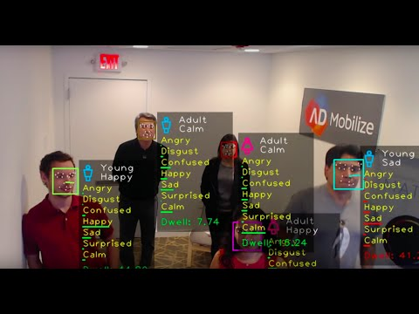

Convolutional Neural Networks (CNNs)

Slide 14
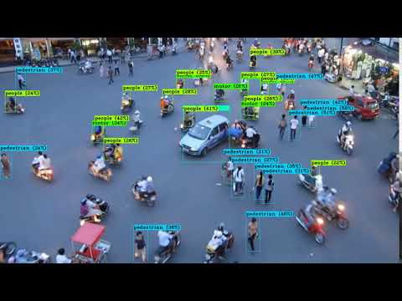
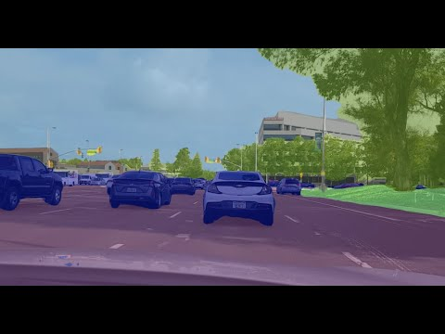
Convolutional Neural Networks (CNNs)

Slide 15
Recurrent Neural Networks (RNNs)
Example Application:
Prediction problems
Machine Translation
Speech Recognition
Language Modelling and Generating Text
Video Tagging
Generating Image Descriptions
Text Summarization
Call Center Analysis
Face detection
ChatBot
OCR Applications as Image Recognition

Slide 16
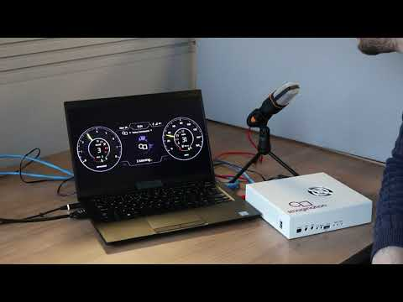
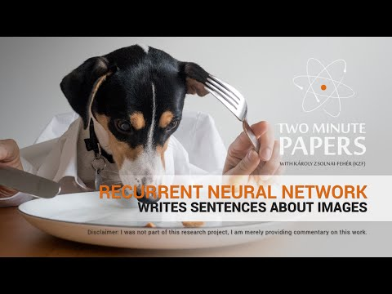
Recurrent Neural Networks (RNNs)

Slide 17
Generative Adversarial Networks (GANs)
Example Applications:
Generate Examples for Image Datasets
Generate Photographs of Human Faces
Generate Realistic Photographs
Generate Cartoon Characters
Image-to-Image Translation
Text-to-Image Translation
Semantic-Image-to-Photo Translation
Face Frontal View Generation
Generate New Human Poses
Photos to Emojis
Photograph Editing
Face Aging
Photo Blending
Super Resolution
Photo Inpainting
Clothing Translation
Video Prediction
3D Object GenerationS

Slide 18


Generative Adversarial Networks (GANs)

Slide 19
Deep Reinforcement Learning (DRL)
Example Application:
Games
Board Games
Card Games
Video Games
Robotics
Manipulation
Locomotion
Robotics Simulators
Natural Language Processing
Neural Machine Translation
Dialogue
Visual Dialogue
Autonomous Driving
Lane Following/Changing
Obstacle Avoidance
Path Planning
Health Care
Discovery and generation of optimal Dynamic Treatment Regimes (DTRs) for chronic diseases.
Business
News Recommendation
Marketing
Advertising
Stock Market Prediction

Slide 20
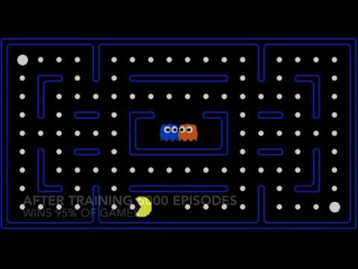
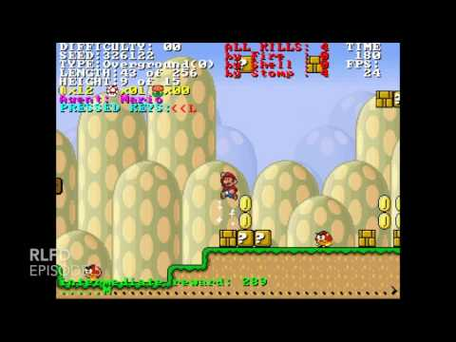
Deep Reinforcement Learning (DRL)

Slide 21
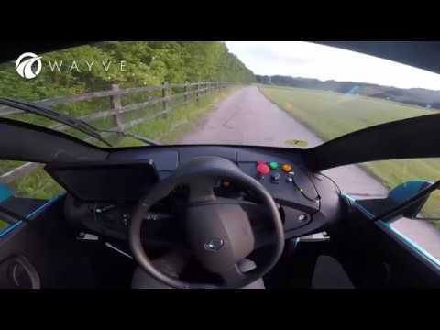
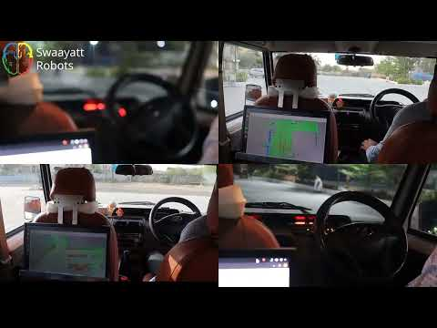
Deep Reinforcement Learning (DRL)

Slide 22
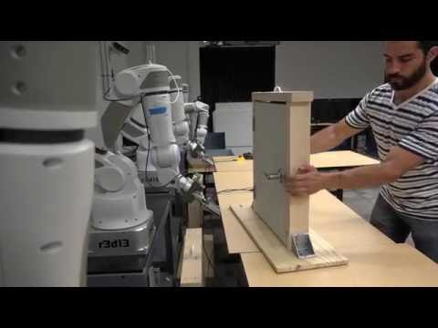
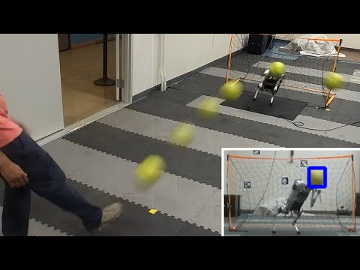
Deep Reinforcement Learning (DRL)

Slide 23
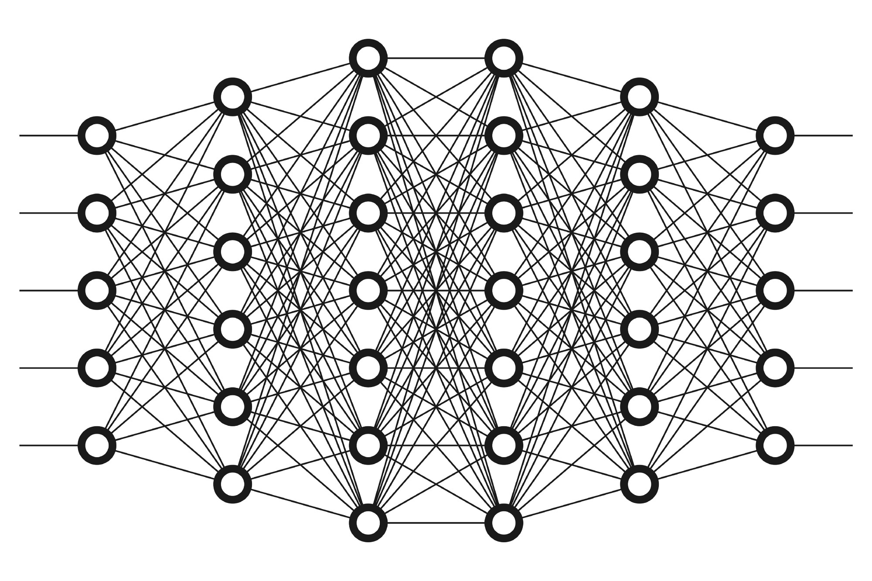
What is deep learning?
A type of machine learning techniques
It uses Deep Artificial Neural Networks
Deep learning algorithms are incredibly complex.
There are different types of neural networks to address specific problems or datasets.

Slide 24
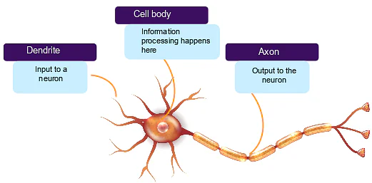
How does our brain works?
The brain sends and receives chemical and electrical signals throughout the body.
Different signals control different processes, and your brain interprets each.
Some messages are kept within the brain, while others are relayed through the spine and across the body’s vast network of nerves to distant extremities.
To do this, the central nervous system relies on billions of neurons (nerve cells).
Human brain has around 86 billions neurons.

Slide 25
How does deep learning works?
Deep learning works with the artificial neurons similar to human brain.
It uses a combination of data inputs, weights, and bias to accurately recognize, classify, and describe objects within the data.
Deep neural networks consist of multiple layers of interconnected nodes, each building upon the previous layer to refine and optimize the prediction or categorization.

Slide 26
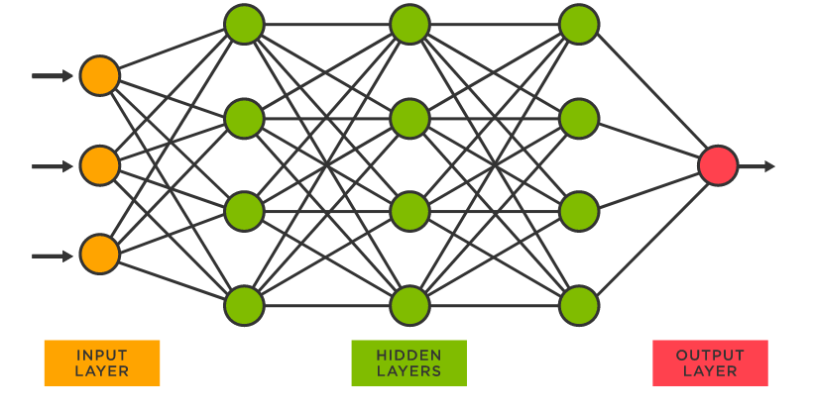
How does deep learning works?
The input and output layers of a deep neural network are called visible layers.
The input layer is where the deep learning model ingests the data for processing.
The output layer is where the final prediction or classification is made.
The layers that are inside the network but invisible are called hidden layers.

Slide 27
What is weight in Deep Learning?
Weight is the parameter within a neural network that transforms input data within the network's hidden layers.
As an input enters the node, it gets multiplied by a weight value and the resulting output is either observed, or passed to the next layer in the neural network.
Often the weights of a neural network are contained within the hidden layers of the network.
Weight affects the amount of influence a change in the input will have upon the output.
A low weight value will have no change on the input.
A larger weight value will more significantly change the output.
Input
X
Weight
=
Output
+
Bias

Slide 28
What is bias in Deep Learning?
Bias represents how far off the predictions are from their intended value.
Biases make up the difference between the function's output and its intended output.
A low bias suggest that the network is making more assumptions about the form of the output
A high bias value makes less assumptions about the form of the output.
Biases are tuned alongside weights by learning algorithms such as gradient descent.
Input
X
Weight
=
Output
+
Bias

Slide 29
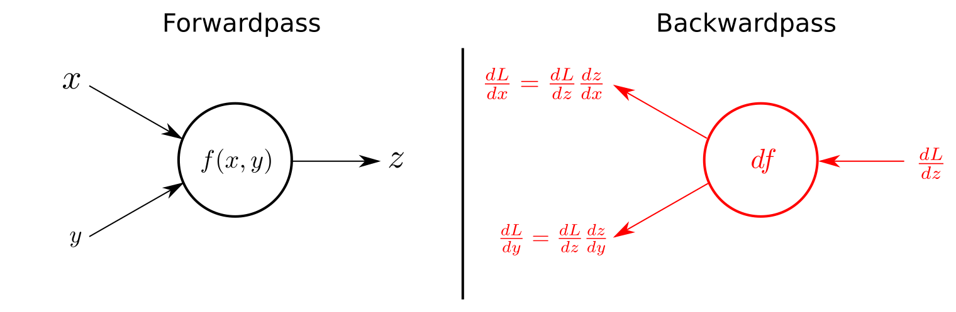
Forward Propagation
Forward Propagation is the way to move from the Input layer (left) to the Output layer (right) in the neural network

Slide 30
Backward propagation
The process of moving from the right to left i.e backward from the Output to the Input layer is called the Backward Propagation.
It uses algorithms, like gradient descent, to calculate errors in predictions and then adjusts the weights and biases of the function by moving backwards through the layers in an effort to train the model.

Slide 31
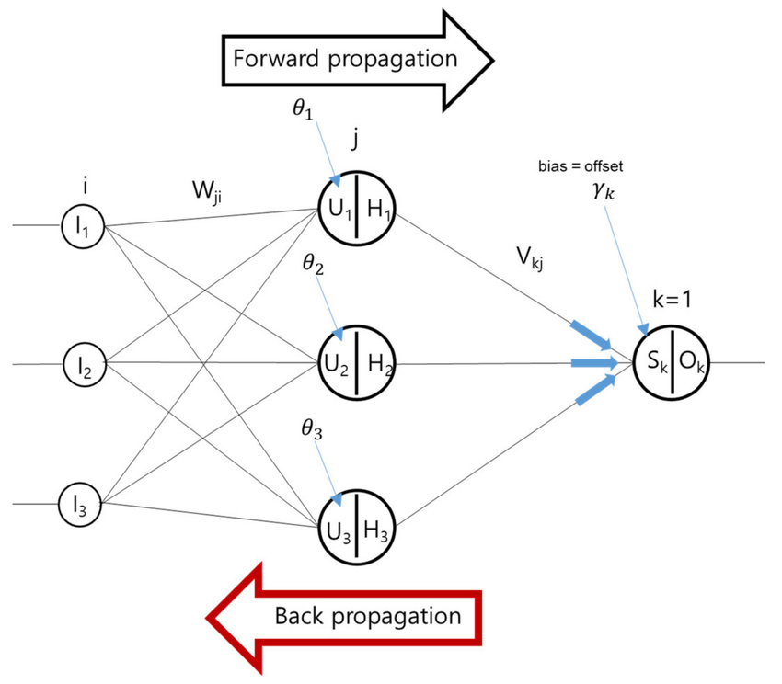
Forward Propagation and Backward Propagation
Deep learning uses forward propagation and backpropagation to make predictions and correct for any errors accordingly.
Deep learning algorithm becomes gradually more accurate over time.

Slide 32
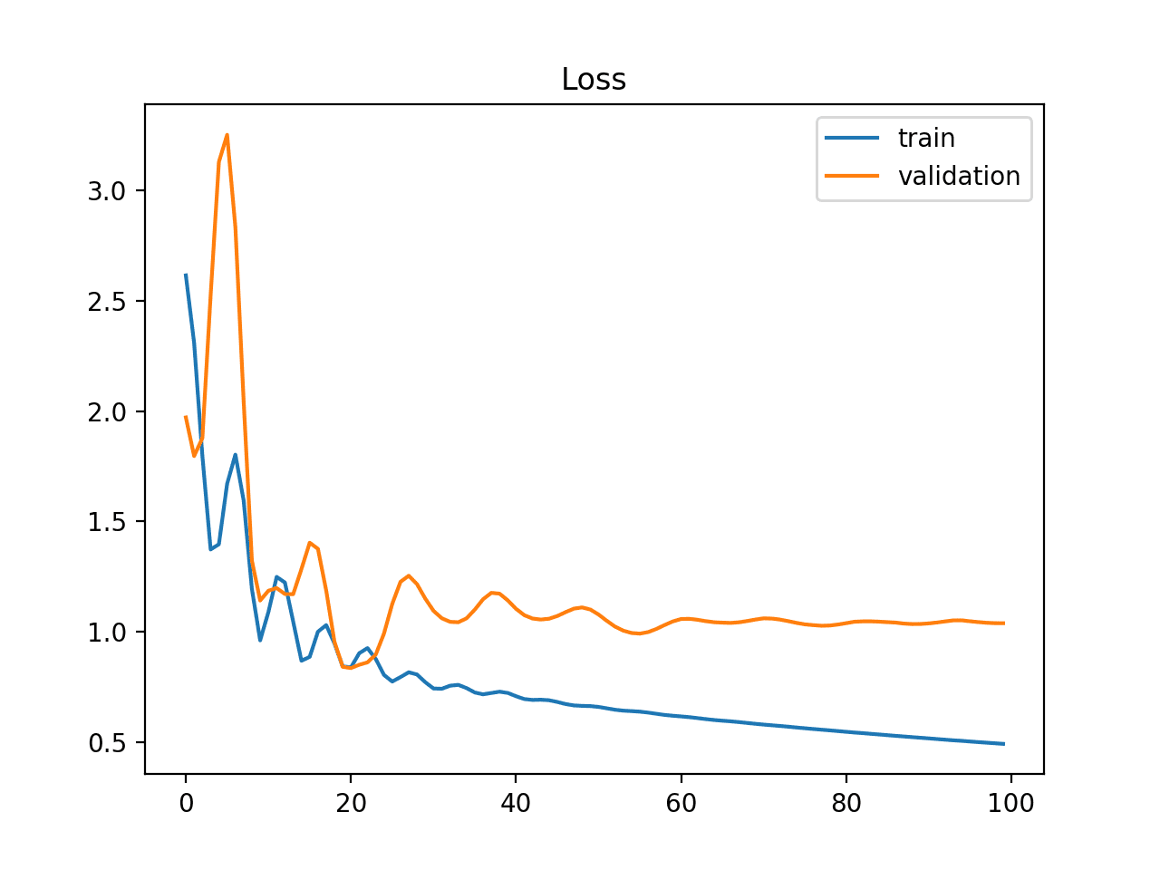
Loss Function
Scientist Lord Kelvin said “If you can’t measure it, you can’t improve it.”
We need to measure something from the model to improve it.
A loss function/error function is for a single training example/input.
if the value of the loss function is lower then it’s a good model otherwise, we have to change the parameter of the model and minimize the loss.
Example Loss Plot of a model

Slide 33
Loss Function
Regression
MSE(Mean Squared Error)
MAE(Mean Absolute Error)
Hubber loss
Classification
Binary cross-entropy
Categorical cross-entropy
AutoEncoder
KL Divergence
GAN
Discriminator loss
Minmax GAN loss
Object detection
Focal loss
Word embeddings
Triplet loss

Slide 34
Gradient Descent
Gradient descent is an optimization algorithm which is commonly-used to train machine learning and deep learning models.
Training data helps these models learn over time
the cost function within gradient descent specifically acts as a barometer, gauging its accuracy with each iteration of parameter updates.
Until the function is close to or equal to zero, the model will continue to adjust its parameters to yield the smallest possible error.

Slide 35
Gradient Descent
Batch gradient descent sums the error for each point in a training set, updating the model only after all training examples have been evaluated.
Stochastic gradient descent (SGD) runs a training epoch for each example within the dataset and it updates each training example's parameters one at a time.
Mini-batch gradient descent combines concepts from both batch gradient descent and stochastic gradient descent. It splits the training dataset into small batch sizes and performs updates on each of those batches.

Slide 36
Local minima and saddle points
When the slope of the cost function is at or close to zero, the model stops learning.
A few scenarios beyond the global minimum can also yield this slope, which are local minima and saddle points.
Local minima has similar shape with a global minimum, where the slope of the cost function increases on either side of the current point.
With saddle points, the negative gradient only exists on one side of the point, reaching a local maximum on one side and a local minimum on the other. Its name inspired by that of a horse’s saddle.
Solution: Noisy gradients can help the gradient escape local minimums and saddle points.

Slide 37
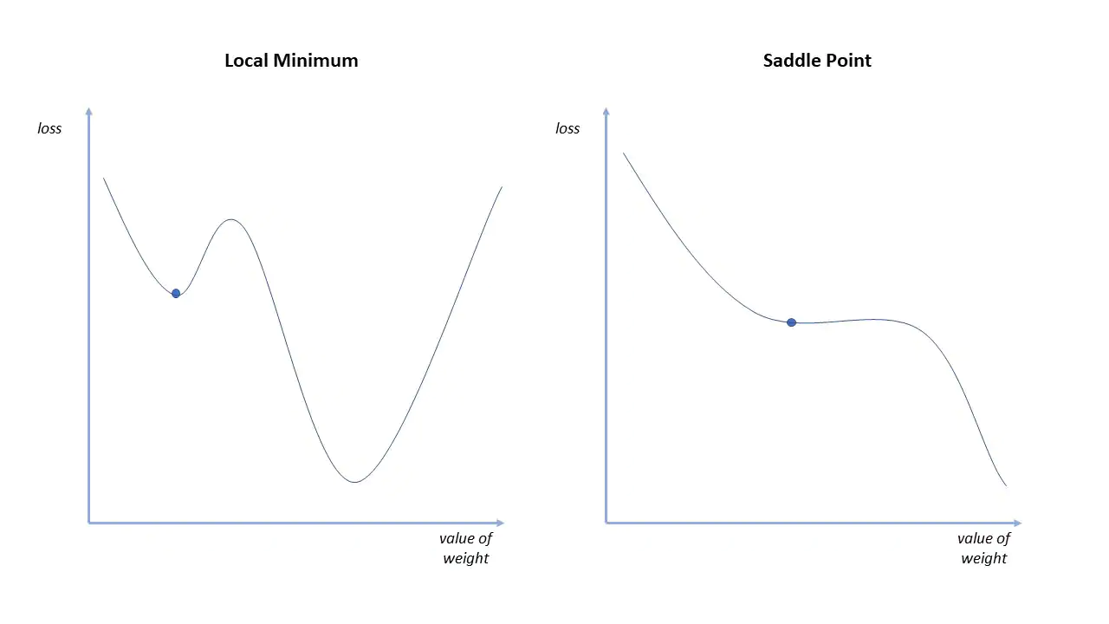
Local minima and saddle points

Slide 38
Vanishing Gradient and Exploding Gradient
Vanishing gradient occurs when the gradient is too small.
During backpropagation, the gradient continues to become smaller, causing the earlier layers in the network to learn more slowly than later layers.
The weight parameters update until they become insignificant.
It will result in an algorithm that is no longer learning.
Solution: Replace the activation function of the network
Exploding gradient happens when the gradient is too large, creating an unstable model.
The model weights will grow too large, and they will eventually be represented as NaN.
Solution: Leverage a dimensionality reduction technique, which can help to minimize complexity within the model.

Slide 39
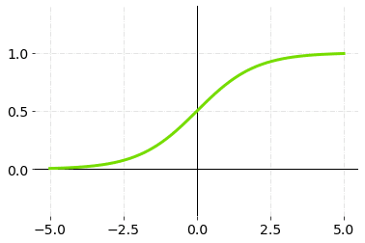
Activation Function - Sigmoid Function
Sigmoid accepts a number as input and returns a number between 0 and 1.
Qualities of activation functions: nonlinearity, continuous differentiation, monotonicity, and a set output range.
It is mainly used in binary classification problems.
It gives the probability of an existence of a particular class.

Slide 40
Activation Function - Sigmoid Function
Advantages
It is non-linear in nature. Combinations of this function are also non-linear, and it will give an analogue activation, unlike binary step activation function. It has a smooth gradient too, and It’s good for a classifier type problem.
The output of the activation function is always going to be in the range (0,1) compared to (-∞, ∞) of linear activation function. As a result, we have defined a range for our activations.
Disadvantages
Sigmoid function gives rise to a problem of “Vanishing gradients” and Sigmoids saturate and kill gradients.
Its output isn’t zero centred, and it makes the gradient updates go too far in different directions. The output value is between zero and one, so it makes optimization harder.
The network refuses to learn more
The network is extremely slow.

Slide 41
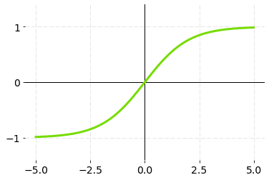
Activation Function - Softmax Function
It is a combination of many sigmoids.
It determines relative probability.
Similar to the sigmoid activation function, the Softmax function returns the probability of each class/labels.
In multi-class classification, softmax activation function is most commonly used for the last layer of the neural network.
The softmax function gives the probability of the current class with respect to others.
It also considers the possibility of other classes too.

Slide 42
Activation Function - Softmax Function
Advantages
Good for multi-label classification and regression tasks.
Disadvantages
Information can be lost if absolute (modulus) values are used, but the exponential takes care of this on its own.

Slide 43
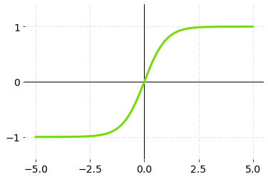
Activation Function - Tanh (Hyperbolic Tangent)
Function
TanH compress a real-valued number to the range [-1, 1].
It’s non-linear and its output is zero-centered.

Slide 44
Activation Function - Tanh (Hyperbolic Tangent)
Function
Advantages
The main advantage of this is that the negative inputs will be mapped strongly to the negative and zero inputs will be mapped to almost zero in the graph of TanH.
TanH is zero-centered, and gradients do not have to move in a specific direction.
Disadvantages
TanH also has the vanishing gradient problem, but the gradient is stronger for Tanh than sigmoid (derivatives are steeper).

Slide 45
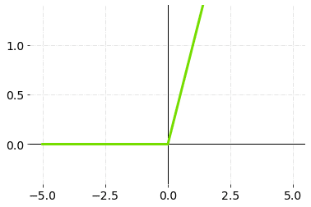
Activation Function - ReLU (Rectified Linear Unit)
Function
It is one of the most commonly used activation function in the applications.
It’s solved the problem of vanishing gradient because the maximum value of the gradient of ReLU function is one.
It also solved the problem of saturating neuron, since the slope is never zero for ReLU function. The range of ReLU is between 0 and infinity.

Slide 46
Activation Function - ReLU (Rectified Linear Unit)
Function
Advantages
Since only a certain number of neurons are activated, the ReLU function is far more computationally efficient when compared to the sigmoid and TanH functions.
It accelerates the convergence of gradient descent towards the global minimum of the loss function due to its linear, non-saturating property.
Disadvantages
One of its limitations is that it should only be used within hidden layers of an artificial neural network model.
Some gradients can be fragile during training.
For activations in the region (x<0) of ReLu, the gradient will be 0 because of which the weights will not get adjusted during descent. That means, those neurons, which go into that state will stop responding to variations in input (simply because the gradient is 0, nothing changes.) This is called the dying ReLu problem.

Slide 47
Underfitting and Overfitting
Underfitting occurs when the model has a very high bias and is unable to capture the complex patterns in the data.
Overfitting occurs when the network is able to accurately predict the samples of the training data but has poor performance and cannot generalize well on the validation and the test data.

Slide 48
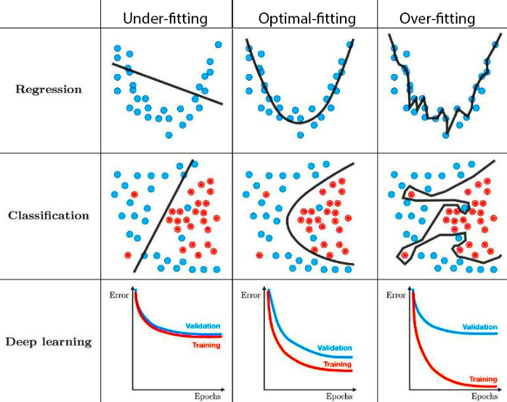
Underfitting and Overfitting

Slide 49
How to handle underfitting?
Increase the model complexity by either increasing the number of parameters of your deep learning model or the order of your model.
Train the model for more epochs.
Ensure that the loss is decreasing gradually over the course of the training.
Otherwise, it is highly likely that there is some kind of bug or problem in the training code/logic itself.
Shuffle the data after every epoch during training.

Slide 50
How to handle overfitting?
Get more training data
Perform Augmentation
Early stopping
Regularization

Slide 51
Augmentation
Use when we cannot get more data.
Augmentation:
Artificially modifying your existing data by means of transforms that resemble the variation you might expect in the real data.
Adding variation in the data.

Slide 52
Early Stopping
Early stopping is a form of regularization to avoid overfitting when training a learner with an iterative method, such as gradient descent.
While training neural networks, gradients are used iteratively from the training data and try to make the model fit better approximate the underlying real-world function.
It stops the training at or near the optimal fitting point.
To decide when to stop, we can monitor certain metrics such as the loss, test_accuracy, val_accuracy and depending on certain conditions being met stop the training.

Slide 53
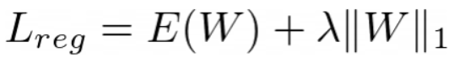
Regularization
L1 Regularization
L1 regularization adds a scaled version of the L1 norm of the weight parameters to the loss function.
Even if the error term would be zero, so long as the weights are non zero we still will have a +ve high Lreg value.
Since the objective of the optimization problem is to minimise Lreg, setting weights to zero would lead to a lower loss.
More zeros in the weights means more sparsity.
Lreg : Regularized loss
E(W) : Error term
λ : Hyperparameter
||W||₁ : L1 norm of the weights

Slide 54
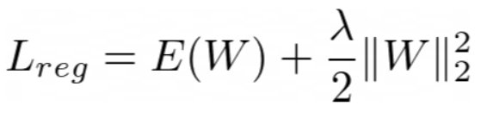
Regularization
L2 Regularization
L2 Regularization adds the squared L2 norm of the weights to the cost/loss/objective function.
It leads to smaller weights.
It is also sometimes referred to as weight decay
Lreg : Regularized loss
E(W) : Error term
λ : Hyperparameter
||W||₂ : L2 norm of the weights

Slide 55
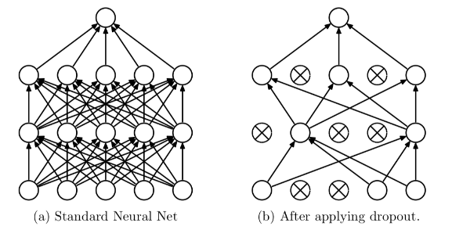
Dropout
Dropout is a technique that drops neurons from the neural network or ‘ignores’ them during training.
After every iteration, different sets of neurons are activated, to prevent some neurons from dominating the process.
Dropout helps us to prevent overfitting, and allows for the rise of deeper and bigger network architectures that can make good predictions on data the network has not seen before.

